Slide 1
IT 1107 Mathematics for IT
Week 11 - Solving linear equations

Slide 2
Solving a system of linear equations using cramer’s rule
First, arrange the system in the following form:
a ₁ x + b ₁ y + c ₁ z = d ₁
a ₂ x + b ₂ y + c ₂ z = d ₂
a ₃ x + b ₃ y + c ₃ z = d ₃
where a _{1, 2, 3}, b _{1, 2, 3}, and c _{1, 2, 3} are the x , y , and z coefficients, respectively, and d _{1, 2, 3} are constants

Slide 3


Next, create a 3×4 matrix in the following manner
This is equivalent to writing
=

Slide 4
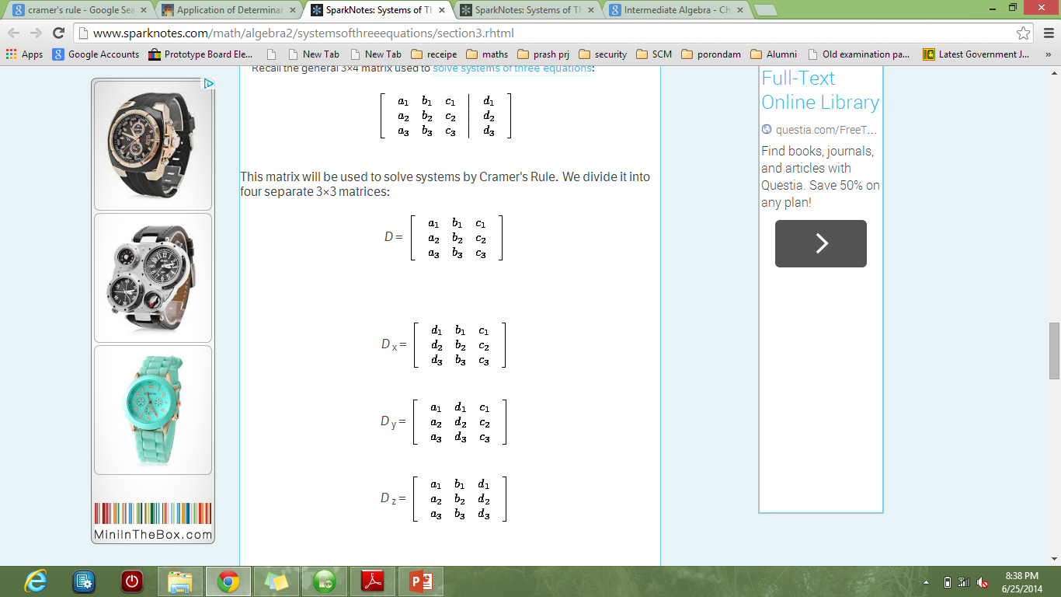
This matrix will be used to solve systems by Cramer's Rule. We divide it into four separate 3×3 matrices:
D is the 3×3 coefficient matrix, and D _{x} , D _{y} , and D _{z} are each the result of substituting the constant column for one of the coefficient columns in D .

Slide 5

Cramer's Rule states that:
x=$\frac{detD_{x}}{\det{D}}$
y=$\frac{detD_{y}}{\det{D}}$
z=$\frac{detD_{z}}{\det{D}}$

Slide 6
Eg: Solve the following system
8x + 10z = 7y + 15 2x + 3y + 8z = 7 5y + 9 = 4x + 2z

Slide 7
Rearrange the system:
8x - 7y + 10z = 15
2x + 3y + 8z = 7
-4x + 5y - 2z = - 9

Slide 8
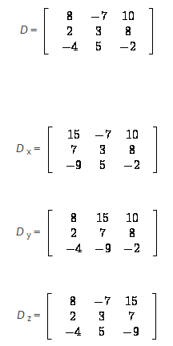

Slide 9
Find the determinants:
detD = (- 48 + 224 + 100) - (- 120 + 320 + 28) = 276 - 228 = 48
detD _{x} = (- 90 + 504 + 350) - (- 270 + 600 + 98) = 764 - 428 = 336
detD _{y} = (- 112 - 480 - 180) - (- 280 - 576 - 60) = - 772 - (- 916) = 144
detD _{z} = (- 216 + 196 + 150) - (- 180 + 280 + 126) = 130 - 226 = - 96

Slide 10
X= 336/48
Y=144/48
Z= -96/48
Thus
X= 7
Y=3
Z= -2

